Slide 1

Findings From Yelp Reviews
Chith Sabesh S Bharadwaj

Slide 2
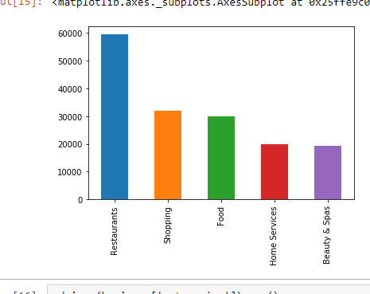
Restaurant category occurs Most frequently

Slide 3
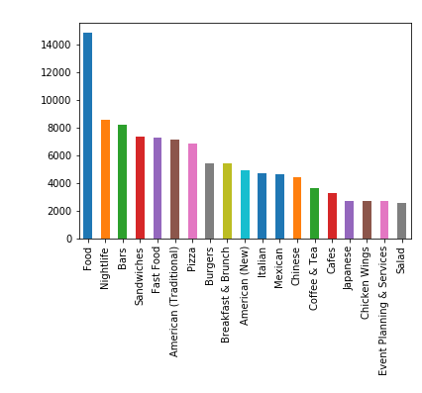
Other categories which occur alongside restaurants

Slide 4
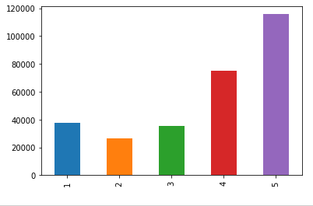
Most amount of Stars

Slide 5
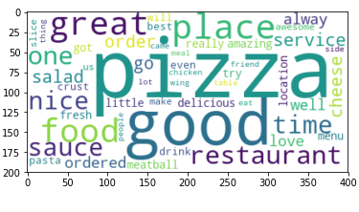
Most words for positive reviews

Slide 6
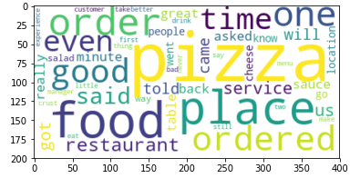
Words for negative review

